Slide 1


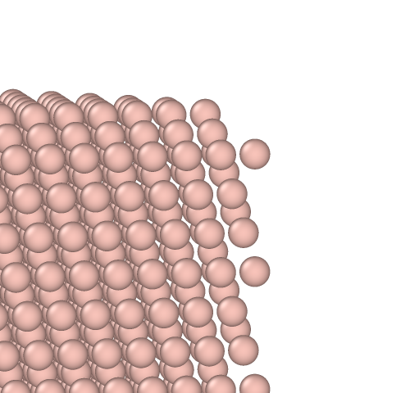
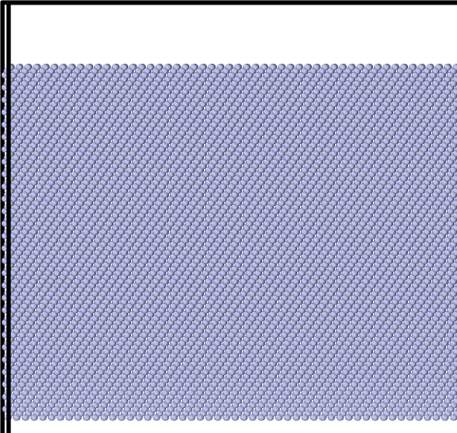
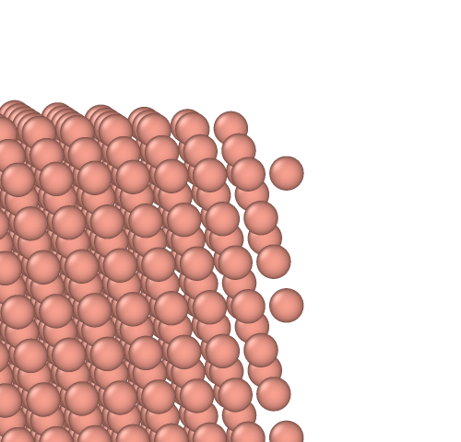
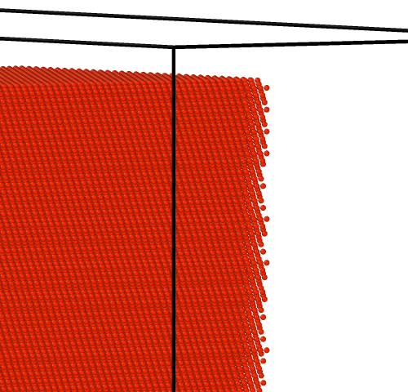
Topic 2 Fusion Irradiation Damage of Tungsten
Bochuan Sun
Material Science & Engineering
Clemson University

Slide 2
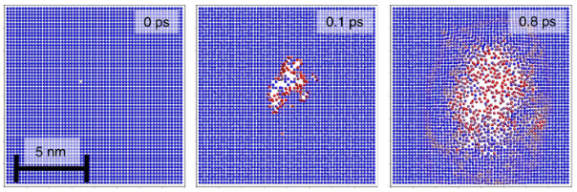
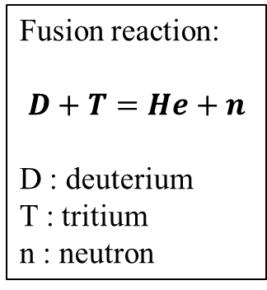
Atomic displacement
Fusion reaction:
$$D+T=He+n$$
D : deuterium
T : tritium
n : neutron
Collision cascade^{[1]}
High-energy particle collision:
Transfer enough energy to move tungsten atoms from their original position. The displacement energy of tungsten (W) is 85 eV.
Low-energy particle collision:
If the kinetic energy of impact particles is insufficient to displace W atoms from their positions, the energy will instead be transferred to the vibrational energy of the W atoms, resulting in the dissipation of heat.
H (D, T) & He atoms
H & He Interstitial atoms, He Clusters, He bubbles
W Self-interstitial atoms (SIAs), vacancies, voids, dislocation loops
Neutrons
Transmutation elements: rhenium, osmium, tantalum, hafnium, iridium, etc.
[1] Nordlund, Kai & Zinkle, S.J. & Sand, Andrea & Granberg, Fredric & Averback,(2018). Improving atomic displacement and replacement calculations with physically realistic damage models. Nature Communications. 9. 10.1038/s41467-018-03415-5.

Slide 3
Irradiation induced defects
H & He Interstitial atom: H and He atoms can stay in the W bulk after irradiation as interstitial atoms
Cluster, bubble: Due to the attractive force between helium atoms, they can cluster together and form bubbles.
Vacancy: W atoms are removed from the original lattice sites (eject by impact or He bubbles) and leave vacancies.
W-SIA: If the W atom is ejected by a He bubble inside the W bulk, it will stay in an interstitial site (<1 1 1> dumbbell sites have the lowest formation energy, ~10.53 eV).
Frenkel pair: a vacancy and a W-SIA. The annealing of the material increases the mobility of atoms, this causes the recombination of Frenkel pairs to occur more frequently.
Void: vacancies can also cluster together and form voids.
Dislocation loop: W-SIAs agglomerate and form prismatic <111> and <100> dislocation loops, since the high binding energy.

Slide 4
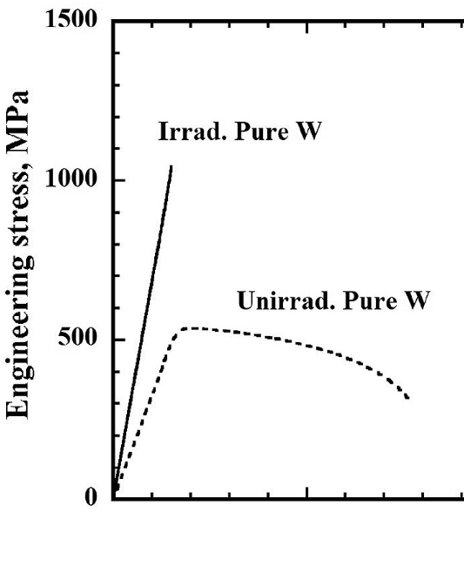


Irradiation hardening
Tensile strength increases and ductility decreases
Defects are obstacles to the dislocation motion
Irradiation embrittlement
Material crack without a significant plastic deformation
The presence of He bubbles and dislocation loops is a major contributor to the embrittlement mechanism.
Ductile-to-brittle transition temperature (DBTT) increases
Stress-strain curves of Pure W [1]
[1] Miyazawa, Takeshi, et al. "Neutron irradiation effects on the mechanical properties of powder metallurgical processed tungsten alloys." Journal of Nuclear Materials 529 (2020): 151910.

Slide 5

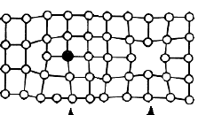
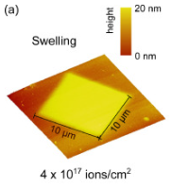
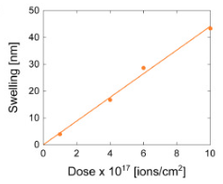
Irradiation swelling
(a)
(b)
The volume increase caused by the interstitial atoms cannot be compensated by the volume decrease caused by vacancies. SIAs will reach the surface and create extra layers of the material.
The process of swelling can exert additional stress on a system. When combined with embrittlement, the joint effect can render a device more susceptible to breaking.
(a). AFM height maps (b) swelling versus irradiation dose ^{[1]}
[1] Allen, Frances I., Peter Hosemann, and Mehdi Balooch. "Key mechanistic features of swelling and blistering of helium-ion-irradiated tungsten." Scripta Materialia 178 (2020): 256-260.

Slide 6
Irradiation creep
Creep: Slow and continuous deformation in metals under constant load or stress.
The mechanism of the irradiation creep:
Irradiation induces point defects in the W, dislocation can absorb those point defects and climb, resulting in the deformation of the material.
The probability of point defects being absorbed by dislocations is uniform without stress, resulting in isotropic deformation of the material.
Under the influence of stress, dislocations with Burgers vectors parallel to the stress direction have a higher tendency to climb, leading to anisotropic deformation of the material and the manifestation of irradiation creep.

Slide 7
Mitigation of irradiation damage
Reduce grain size: Reduced the density of defects
The small grain size will have more grain boundaries, they can be sinks for defects.
Defects absorbed by grain boundaries will prevent them from propagating in W, while the grain boundaries also act as obstacles for the dislocation movement and increase the hardening of the material.
Annealing
Accelerates the recombination of Frenkel pairs.
Alloying (especially form W-based HEAs)
Modify the migration properties of defects and have more recombination of Frenkel pairs.
Cocktail effect allows optimizing the composition to improve ductility.

Slide 8
Any Questions

Slide 9
He: 3.5 MeV (most heat plasma)
n: 14 MeV

